Slide 1
Lecture 14
Describe Azure management infrastructure
Instructor : Engr. Tehmeed

Slide 2
Describe Azure management infrastructure
The management infrastructure includes Azure resources and resource groups, subscriptions, and accounts. Understanding the hierarchical organization will help you plan your projects and products within Azure.

Slide 3
Azure resources and resource groups
A resource is the basic building block of Azure. Anything you create, provision, deploy, etc. is a resource. Virtual Machines (VMs), virtual networks, databases, cognitive services, etc. are all considered resources within Azure.
Resource groups are simply groupings of resources. When you create a resource, you’re required to place it into a resource group. While a resource group can contain many resources, a single resource can only be in one resource group at a time. Some resources may be moved between resource groups, but when you move a resource to a new group, it will no longer be associated with the former group. Additionally, resource groups can't be nested, meaning you can’t put resource group B inside of resource group A.
Resource groups provide a convenient way to group resources together. When you apply an action to a resource group, that action will apply to all the resources within the resource group. If you delete a resource group, all the resources will be deleted. If you grant or deny access to a resource group, you’ve granted or denied access to all the resources within the resource group.

Slide 4
Azure resources and resource groups
When you’re provisioning resources, it’s good to think about the resource group structure that best suits your needs.
For example, if you’re setting up a temporary dev environment, grouping all the resources together means you can deprovision all of the associated resources at once by deleting the resource group. If you’re provisioning compute resources that will need three different access schemas, it may be best to group resources based on the access schema, and then assign access at the resource group level.
There aren’t hard rules about how you use resource groups, so consider how to set up your resource groups to maximize their usefulness for you.

Slide 5
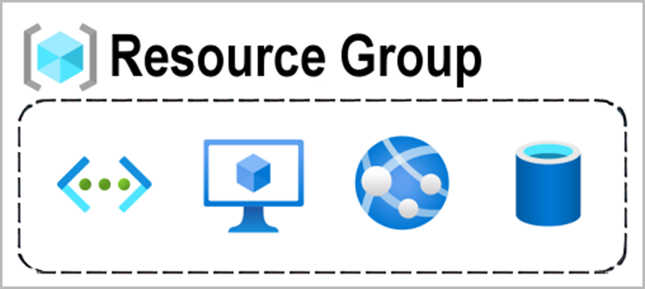
Azure resources and resource groups

Slide 6
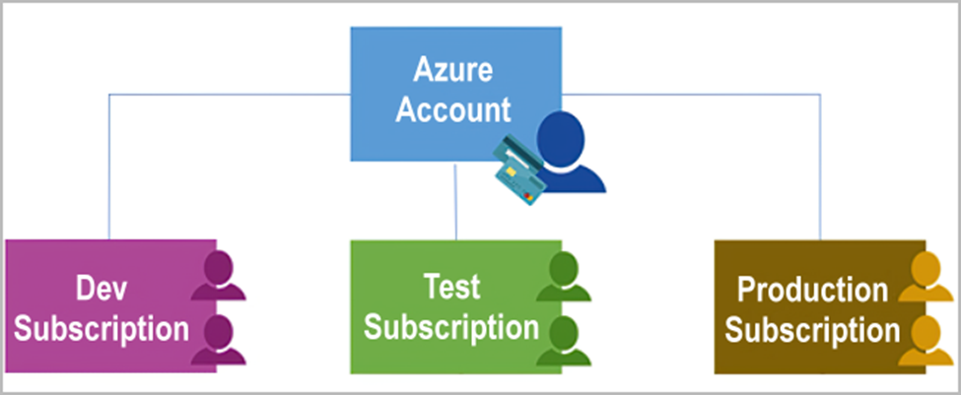
Azure subscriptions
In Azure, subscriptions are a unit of management, billing, and scale. Similar to how resource groups are a way to logically organize resources, subscriptions allow you to logically organize your resource groups and facilitate billing.
Using Azure requires an Azure subscription. A subscription provides you with authenticated and authorized access to Azure products and services. It also allows you to provision resources. An Azure subscription links to an Azure account, which is an identity in Microsoft Entra ID or in a directory that Microsoft Entra ID trusts.

Slide 7
Azure subscriptions
An account can have multiple subscriptions, but it’s only required to have one. In a multi-subscription account, you can use the subscriptions to configure different billing models and apply different access-management policies. You can use Azure subscriptions to define boundaries around Azure products, services, and resources. There are two types of subscription boundaries that you can use:
• Billing boundary: This subscription type determines how an Azure account is billed
for using Azure. You can create multiple subscriptions for different types of billing
requirements. Azure generates separate billing reports and invoices for each
subscription so that you can organize and manage costs.
• Access control boundary: Azure applies access-management policies at the
subscription level, and you can create separate subscriptions to reflect different
organizational structures. An example is that within a business, you have different
departments to which you apply distinct Azure subscription policies. This billing
model allows you to manage and control access to the resources that users
provision with specific subscriptions.

Slide 8
Create additional Azure subscriptions
Similar to using resource groups to separate resources by function or access, you might want to create additional subscriptions for resource or billing management purposes. For example, you might choose to create additional subscriptions to separate:
• Environments: You can choose to create subscriptions to set up separate
environments for development and testing, security, or to isolate data for
compliance reasons. This design is particularly useful because resource access
control occurs at the subscription level.
• Organizational structures: You can create subscriptions to reflect different
organizational structures. For example, you could limit one team to lower-cost
resources, while allowing the IT department a full range. This design allows you to
manage and control access to the resources that users provision within each
subscription.
• Billing: You can create additional subscriptions for billing purposes. Because costs
are first aggregated at the subscription level, you might want to create
subscriptions to manage and track costs based on your needs. For instance, you
might want to create one subscription for your production workloads and another
subscription for your development and testing workloads.

Slide 9
Azure management groups
The final piece is the management group. Resources are gathered into resource groups, and resource groups are gathered into subscriptions. If you’re just starting in Azure that might seem like enough hierarchy to keep things organized. But imagine if you’re dealing with multiple applications, multiple development teams, in multiple geographies.
If you have many subscriptions, you might need a way to efficiently manage access, policies, and compliance for those subscriptions. Azure management groups provide a level of scope above subscriptions. You organize subscriptions into containers called management groups and apply governance conditions to the management groups. All subscriptions within a management group automatically inherit the conditions applied to the management group, the same way that resource groups inherit settings from subscriptions and resources inherit from resource groups. Management groups give you enterprise-grade management at a large scale, no matter what type of subscriptions you might have. Management groups can be nested.

Slide 10
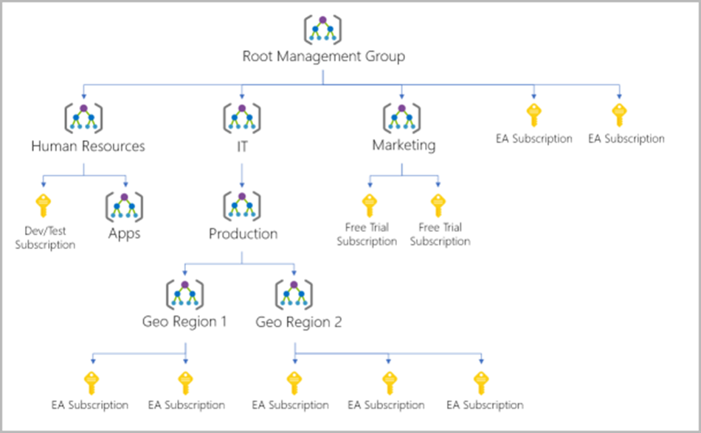
Management group, subscriptions, and resource group hierarchy
You can build a flexible structure of management groups and subscriptions to organize your resources into a hierarchy for unified policy and access management. The following diagram shows an example of creating a hierarchy for governance by using management groups.

Slide 11
Management group, subscriptions, and resource group hierarchy
Some examples of how you could use management groups might be:
• Create a hierarchy that applies a policy. You could limit VM locations to the US West Region in a group called
Production. This policy will inherit onto all the subscriptions that are descendants of that management group and will
apply to all VMs under those subscriptions. This security policy can't be altered by the resource or subscription owner,
which allows for improved governance.
• Provide user access to multiple subscriptions. By moving multiple subscriptions under a management group, you can
create one Azure role-based access control (Azure RBAC) assignment on the management group. Assigning Azure
RBAC at the management group level means that all sub-management groups, subscriptions, resource groups, and
resources underneath that management group would also inherit those permissions. One assignment on the management
group can enable users to have access to everything they need instead of scripting Azure RBAC over different
subscriptions.

Slide 12
Management group, subscriptions, and resource group hierarchy
Important facts about management groups:
• 10,000 management groups can be supported in a single directory.
• A management group tree can support up to six levels of depth. This limit doesn't include the root level or the
subscription level.
• Each management group and subscription can support only one parent.

Slide 13

Any Questions ?

